Slide 1

Timetable Wiz Advanced Timetable Generation Solution For Educational Institutes
Project-ID 24-25J-238

Slide 2






MEMBERS
Supervisor Mr.Jeewaka Perera
Co-Supervisor Mrs.Sasini Hathurusinghe
Team Leader Weerasinghe K.D.E.I
Team Member Wijayawardhana G.L.C.N.D
Team Member
Udayantha D.M S
Team Member
De Silva K.H.P.N

Slide 3

Presentation Contents
01
Introduction to Research Project
02
Discussion On Research Question & Objectives
03
Explain Research Individual Components
04
Conclusion

Slide 4


Introduction
What is time why is important?
In any organization or in our day-to-day lives time is a valuable resource
Time equals money
Education institutes in particular need effective time management for smooth operations
Schedules drive key activities: assessments , examinations and course schedules
Deadlines are non-negotiable in any critical organization
Timely execution of tasks is a crucial need

Slide 5
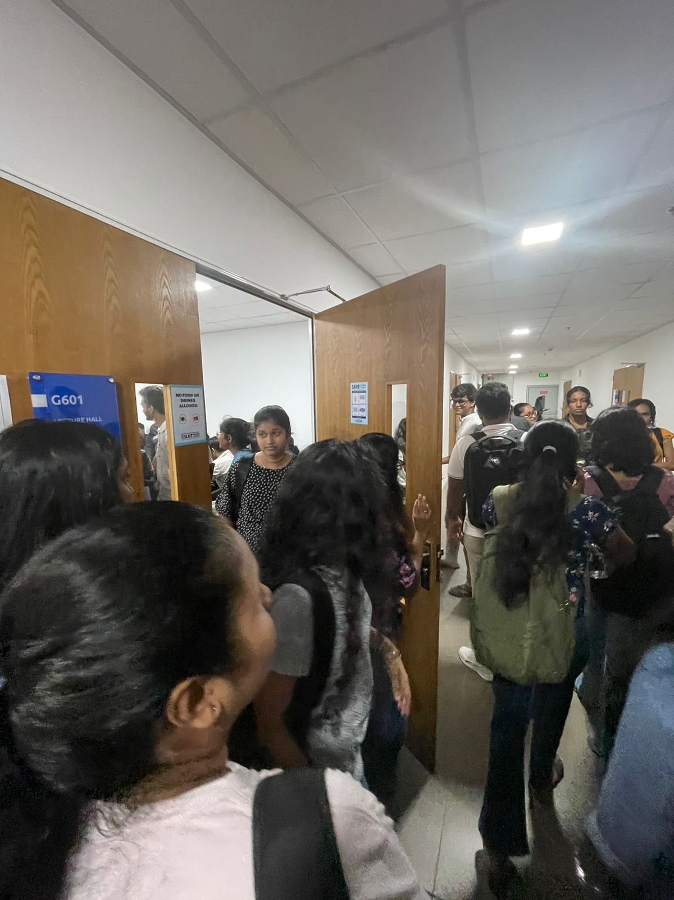
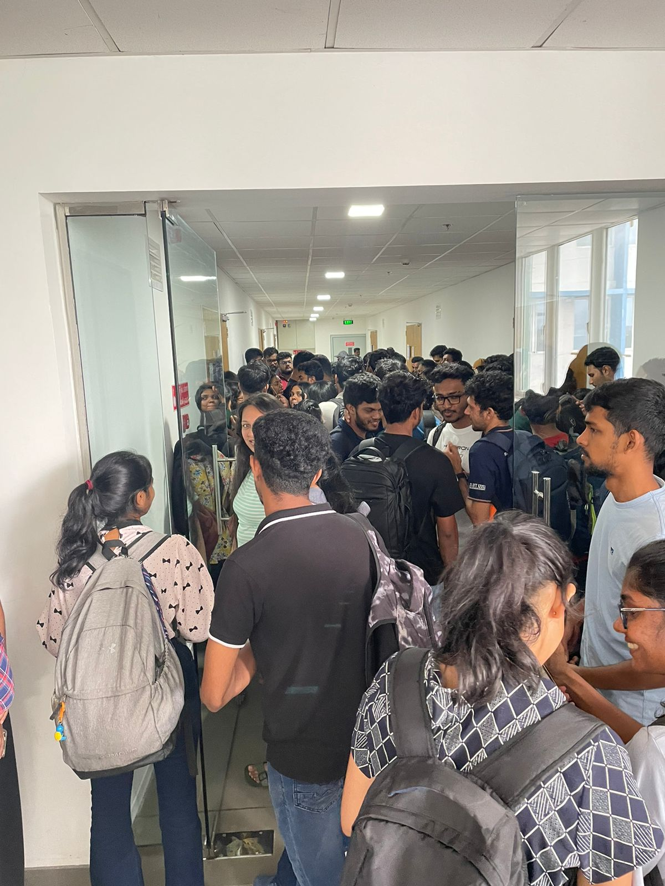
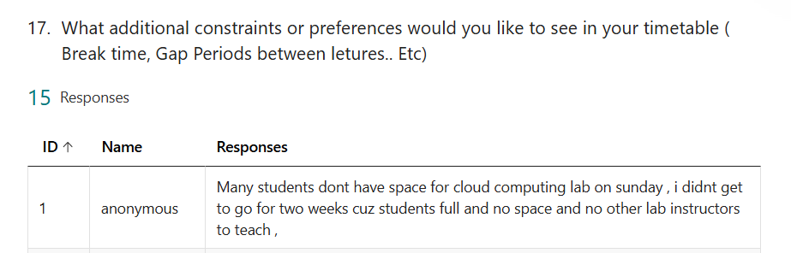
Research Problem
In Outside view Timetables look like a simple
Timetable scheduling is categorized as an NP-Hard problem [2]
Being NP-Hard, Timetable Problem offers multiple constraints
As number Constraints and variables increases, the number of possible schedules grows exponentially making it infeasible to find optimal solution quickly
Unforeseen circumstances would require timetable to adapt in real time
Finite Resources of university must be accommodated efficiently in order meet effective timetable requirements
As Educational institute expand and diversify scalability of scheduling requirement becomes increasingly important
No Students > Allocated Space

Slide 6
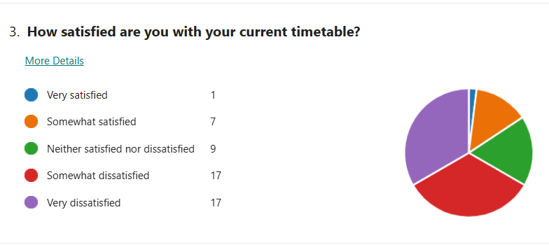
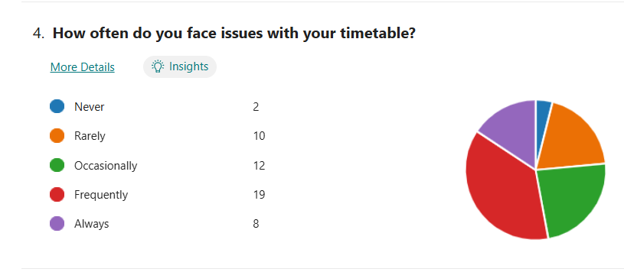
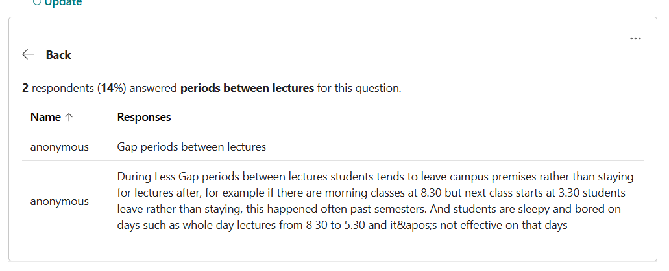
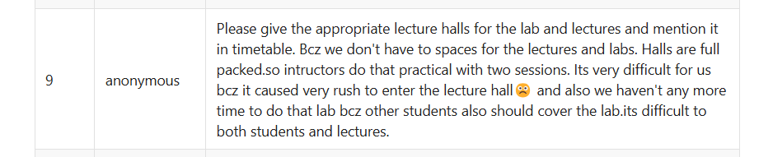
Research Problem Cont.[1]

Slide 7
Main Objective
Research and develop advanced timetabling software that can use optimization techniques such as genetic algorithms, reinforcement learning, and ant colony optimization. Additionally, create an evaluation method to evaluate the algorithms' performance in generating timetables, and provide a user-friendly software to meet scheduling needs.

Slide 8
Detailed Objetives
Develop Advanced Timetabling Software:
Utilize cutting-edge optimization techniques, including genetic algorithms, reinforcement learning, and colony optimization.
Evaluation Criteria
Research and Develop effective timetable evaluation method for used algorithms
Establish a Research Framework:
Build a strong research foundation that supports future studies in scheduling optimization, contributing to ongoing advancements in the field.
Ensure User-Friendly Experience:
Prioritize a user-centric design by integrating features such as a chatbot interface for easy interaction, Role-Based Access Control (RBAC) for security and authorization calendar integration and Editable Interface for generated timetables for seamless scheduling.

Slide 9
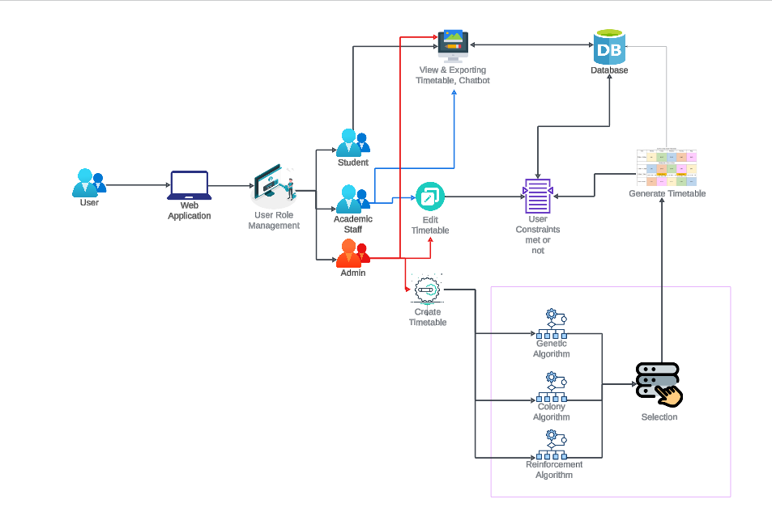
System Overview Diagram

Slide 10
Proposed Technologies
Frontend Requirements
Programming Language - JavaScript
Libraries - React, ViteJS
Tools - NodeJS, Tailwind CSS
System Requirements
Operating System - Cross Platform
Software - Python, Node.js, PostgreSQL
Algorithm Requirements
Language - python
Libraries - NumPy, SciPy, ACO, Matplotlib
Environment - Jupiter Notebook
Backend Requirements
Programming Language - Python, Flask
Database - PostgreSQL

Slide 11
IT21259852| Weerasinghe K.D.E.I
BSc (Hons) Degree in Information Technology (specialization in Information Technology)
IT21259852 | Weerasinghe K.D.E.I | 24-25J-238

Slide 12

Component 01: Research Develop Genetic Algorithms(GA’s) for Timetable Generationand Contribute to RBAC and Export API Development
Introduction
Research Gap
Research Problem
Specific and Sub Objective
IT21259852 | Weerasinghe K.D.E.I | 24-25J-238

Slide 13
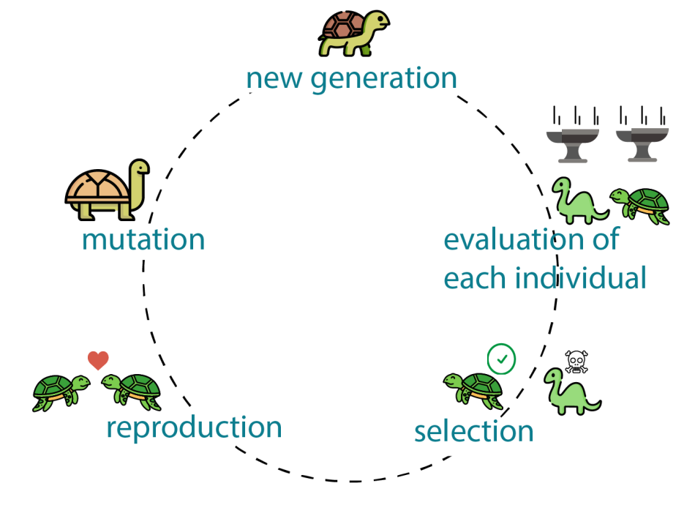

Introduction To Component
Genetic Algorithms are nature inspired method developed under principals of natural selection
GAs are known for their usage in solving Np-Hard problems [1]
GAs are good at navigating through large complex search spaces
Why GA’s -> GAs are good at handling multiple constraints
Flexibility and Adaptability
Develop UI/UX and Implement Role-Base Access Controls in the system
Create Role based Views for timetables and Implement an Export Api to respective institutional Calendars
IT21259852 | Weerasinghe K.D.E.I | 24-25J-238

Slide 14
RESEARCH GAP
 | Usage Of Clashes Method | User Defined Constraints as Input | Variable Population Size | Three Parent Genetic Algorithms | Dynamic Chromosomes | Usage of Selection Method as Roulette wheel | Consideration of soft constraints
[1] Genetic Algorithms for university course scheduling | yes | No | No | No | No | No | yes
[2]Genetic Algorithms using three parents | yes | No | No | Yes | No | No | yes
[3] Dynamic Chromosomes | No | No | No | No | Yes | Yes | yes
[4] Mult objective GAs | No | No | Yes | No | No | Yes | yes
[5] Novel genetic algorithms | Yes | No | No | No | No | Yes | No
Proposed System | Yes | Yes | Yes | Yes | Yes | Yes | Yes
Features
Researches
IT21259852 | Weerasinghe K.D.E.I | 24-25J-238

Slide 15

RESEARCH QUESTION
How To Research and implement genetic algorithms for fully-fledged timetable generation system
Explore and Evaluate various genetic algorithms to find the most suitable methods for various needs of timetabling
IT21259852 | Weerasinghe K.D.E.I | 24-25J-238

Slide 16

Main Objective And Sub Objective
Main Objective
Research and implement genetic algorithms to generate timetables and contribute to the full stack development process of scheduling system
Sub Objective
Design genetic algorithm frameworks suitable for scheduling
Identify key areas of improvement of the algorithm
Implement variations of genetic algorithms such as non-donated sorting genetic algorithms (NSGA –II) and Multi-Objective Evolutionary algorithms based on decomposition (MOEA/D), Strength Pareto (SPEA2)
Implement a method to satisfy both hard and soft constraints
Develop Role base Access on the software
Create features to allow users to view and export their perspective timetables
Integrate an Api that enable users to seamlessly add their schedules to personal institute calendar applications
IT21259852 | Weerasinghe K.D.E.I | 24-25J-238

Slide 17

METHOLOGY
Component Diagram
Component Specific Requirements
Work Break Down Structure
IT21259852 | Weerasinghe K.D.E.I | 24-25J-238

Slide 18
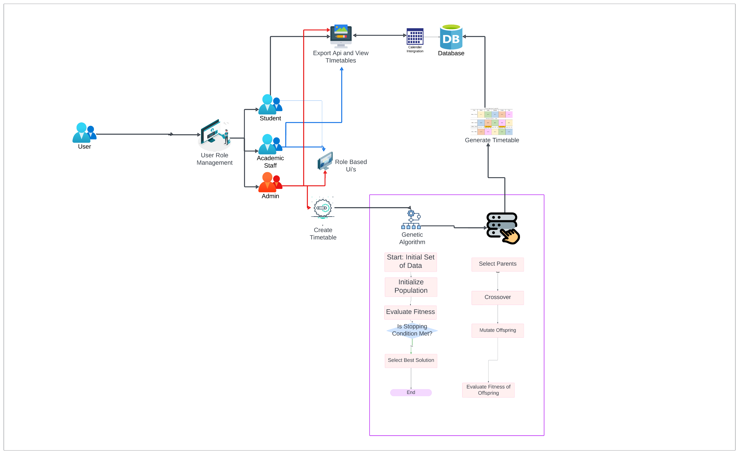
COMPONENT DIAGRAM
Colony Optimization for Timetable Scheduling & Manual Editing Feature
IT21259852 | Weerasinghe K.D.E.I | 24-25J-238

Slide 19
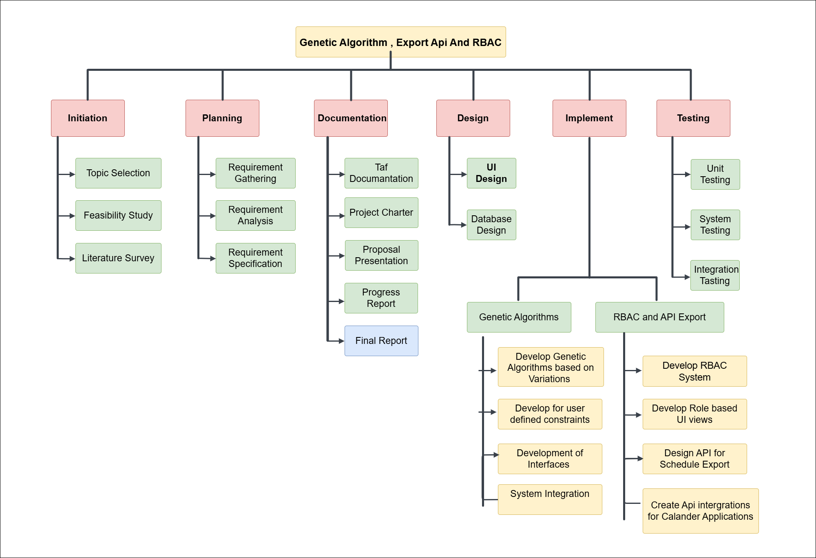
WORK BREAK DOWN STRUCTURE
IT21259852 | Weerasinghe K.D.E.I | 24-25J-238

Slide 20

Component Specific Requirements
Functional Requirement | Non-Functional Requirement
Generate Feasible Timetable Solutions using Genetic Algorithms , ensuring hard and soft constraints Support Multiple Variations of genetic algorithms for timetable generation System Should Support Role base access for different users ( Students, Lecturers, admins) System Should have different views for different entities of timetables System Should Provide an Api for exporting timetables to personal or institutional Calander applications | Performance Usability Reliability Scalability Security Maintainability Compatibility
IT21259852 | Weerasinghe K.D.E.I | 24-25J-238

Slide 21
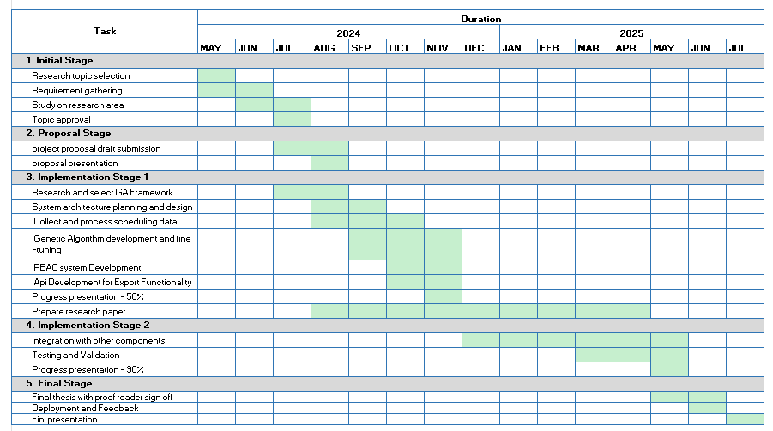
GANTT CHART
IT21172182 | Wijayawardhana G.L.C.N.D | IT21172182

Slide 22
References
[1] Herath, Achini Kumari, "Genetic Algorithm For University Course Timetabling Problem" (2017). Electronic Theses and Dissertations. 443
[2] Herath, Achini Kumari “Timetabling with Three-Parent Genetic Algorithm: a Preliminary Study (2018)”
[3] G. Alnowaini and A. A. Aljomai, "Genetic Algorithm For Solving University Course Timetabling Problem Using Dynamic Chromosomes," 2021 International Conference of Technology, Science and Administration (ICTSA), Taiz, Yemen, 2021, pp. 1-6, doi: 10.1109/ICTSA52017.2021.9406539.
[4] S. Abdullah, H. Turabieh, B. McCollum and P. McMullan, "A multi-objective post enrolment course timetabling problems: A new case study," IEEE Congress on Evolutionary Computation, Barcelona, Spain, 2010, pp. 1-7, doi: 10.1109/CEC.2010.5586227
[5] A. H. Khan and T. Imtiaz, "A Novel Genetic Algorithm Based Timetable Generator for Optimized University Timetable Solution," 2024 International Conference on Engineering & Computing Technologies (ICECT), Islamabad, Pakistan, 2024, pp. 1-6, doi: 10.1109/ICECT61618.2024.10581296.
IT21259852 | Weerasinghe K.D.E.I | 24-25J-238

Slide 23
It21208980- de Silva k. h. p. n
BSc (Hons) Degree in Information Technology (specialization in Information Technology)
IT21208980 | De Silva K. H. P. N | 24-25J-238

Slide 24
Component 2: Research and Development Reinforcement Learning Algorithm for Timetable Generation
Introduction
Research Gap
Research Problem
Specific and Sub Objective
IT21208980 | De Silva K. H. P. N | 24-25J-238

Slide 25

INTRODUCTION
Reinforcement Learning (RL) is a type of mechine learning where agents learn to make decisions by interacting with their environment.
RL Agents are trained to optimize scheduling by exploring different actions and learning from rewards or penalties.
Q-Learning enables agents to learn the best scheduling strategies through trial and error.
Deep Q-Learning (DQL) extends Q-Learning using neural networks for handling more complex scheduling tasks.
Multi-Agent RL involves multiple agents working together to optimize the overall schedule, accommodating various constraints.
Reward Mechanisms are designed to align with scheduling goals, such as minimizing conflicts and maximizing resource utilization.
RL Techniques offer flexibility and adaptability, making them effective for dynamic and complex timetable scheduling scenarios.
IT21208980 | De Silva K. H. P. N | 24-25J-238

Slide 26
RESERCH GAP
Research | Research Gap | Multi-Agent Reinforcement learning(MARL) | User Defined Constraints | Real-Time Optimization
Deep-Reinforcement Learning based dynamic optimization of bus timetable[1] | No | No | Yes
A reinforcement learning approach for dynamic multi-objective optimization[4] | Yes | No | Yes
Multi-Agent Deep Reinforcement Learning for Large-Scale Traffic Signal Control[2] | No | No | Yes
A Review of Reinforcement Learning Based Intelligent Optimization for Manufacturing Scheduling [3] | Yes | No | Yes
Proposed System | Yes | Yes | Yes
IT21208980 | De Silva K. H. P. N | 24-25J-238

Slide 27

RESERCH QUESTION
“How can Reinforcement Learning algorithms be effectively implemented in university timetable scheduling systems to optimize scheduling decisions, minimize conflicts, and adapt to dynamically changing environments and constraints while maintaining efficiency and scalability?”
IT21208980 | De Silva K. H. P. N | 24-25J-238

Slide 28

MAIN AND SUB OBJECTIVE
Main Objectives
Research: Develop a specialized scheduling optimization system for educational environments using Reinforcement Learning (RL) methods.
System Development: Create an ETL process to handle and extract data from CSV, system, and Excel files
Sub Objectives
Develop and customize RL algorithms like Q-Learning, DQL, and SARSA to tackle complex scheduling challenges and adapt to changing conditions.
Ensure seamless integration with the RL scheduling system for efficient data management.
IT21208980 | De Silva K. H. P. N | 24-25J-238

Slide 29
METHOLOGY
Component Diagram
Key Technology
Project Requirement
Work Break Down Structure
IT21208980 | De Silva K. H. P. N | 24-25J-238

Slide 30
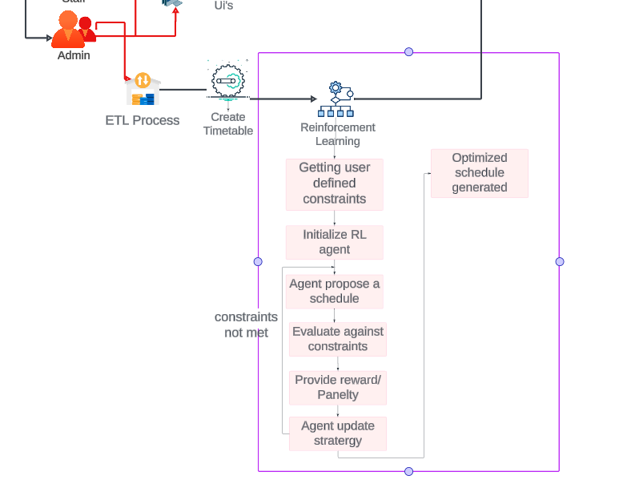
COMPONENT DIAGRAM
Reinforcement Learning for Timetable Scheduling & Manual Editing Feature
IT21208980 | De Silva K. H. P. N | 24-25J-238

Slide 31
Key Technology
Frontend Requirements
Programming Language - JavaScript
Libraries - React, ViteJS
Tools - NodeJS, Tailwind CSS
System Requirements
Operating System - Cross Platform
Software - Python, Node.js, PostgreSQL
Algorithm Requirements
Language - python
Libraries - NumPy, TensorFlow/PyTorch , OpenAI Gym, Matplotlib
Environment - Jupiter Notebook
Backend Requirements
Programming Language - Python, Flask
Database - PostgreSQL
IT21208980 | De Silva K. H. P. N | 24-25J-238

Slide 32
PROJECT REQUIREMENT
Functional Requirement | Non-Functional Requirement
Generate Schedules Using RL Algorithms Manual Adjustment of Schedules. Feedback and Learning Mechanism. Real-Time Conflict Detection. ETL System for Data Handling. | Performance Usability Reliability Scalability Security Maintainability Compatibility
IT21208980 | De Silva K. H. P. N | 24-25J-238

Slide 33
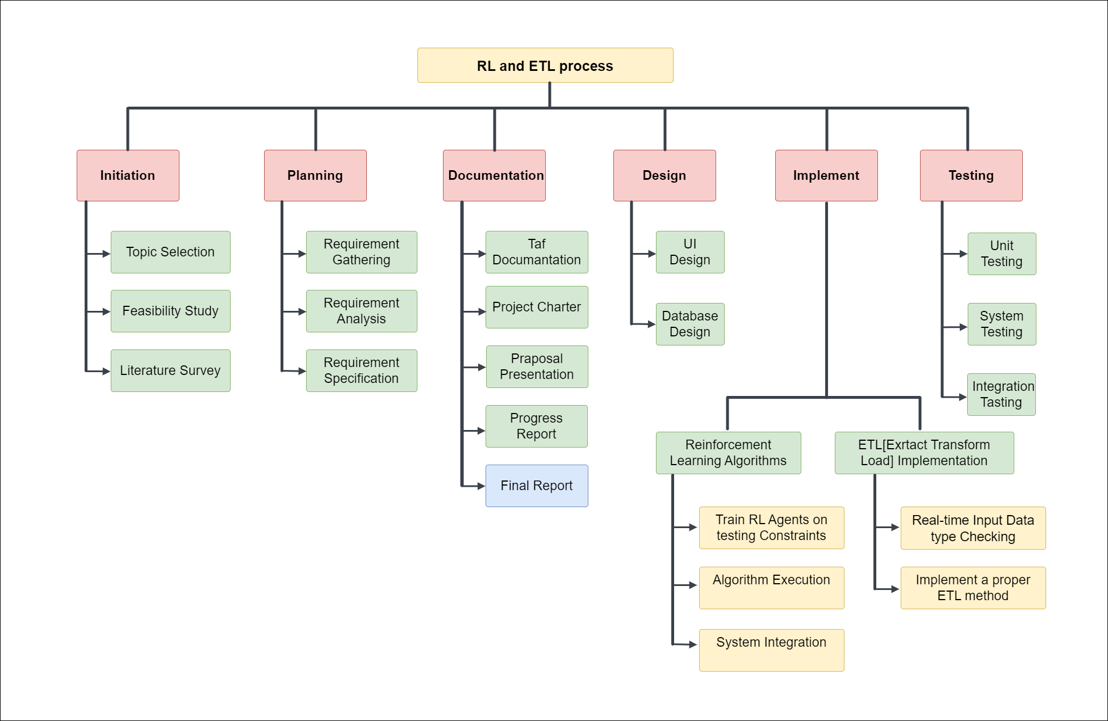
WORK BREAK DOWN STRUCTURE
IT21208980 | De Silva K. H. P. N | 24-25J-238

Slide 34
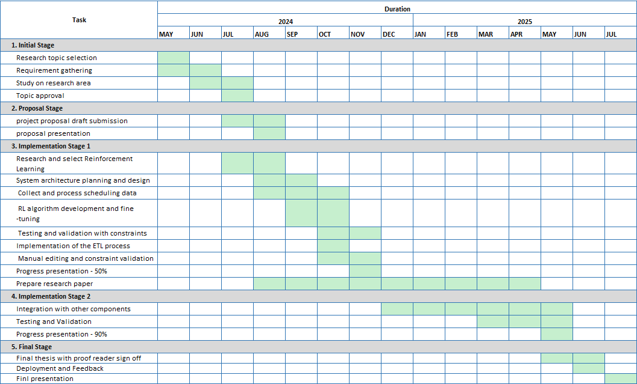
GANTT CHART
IT21208980 | De Silva K. H. P. N | 24-25J-238

Slide 35
REFERENCES
[1] X. Z. C. W. Guanqun Ai, "Deep Reinforcement Learning based dynamic optimization of bus timetable," [Online]. Available: https://www.sciencedirect.com/science/article/abs/pii/S1568494622008018.
[2]"MADRL(Multi-AgentDeepReinforcementLearning),"[Online].Available: https://drive.google.com/drive/folders/1UdSZBGoyEDig_76Xb2tQI6z-x3Mfx2yL?usp=sharing.
[3] "A Review of Reinforcement Learning Based Intelligent Optimization for Manufacturing Scheduling," [Online]. Available: https://ieeexplore.ieee.org/abstract/document/9673698.
[4] "A reinforcement learning approach for dynamic multi-objective optimization," [Online]. Available: https://www.sciencedirect.com/science/article/abs/pii/S0020025520308677.
[5] S. Yeo, S. Lee, B. Choi and S. Oh, "Integrate multi-agent simulation environment and multi-agent reinforcement learning (MARL) for real-world scenario," 2020 International Conference on Information and Communication Technology Convergence (ICTC), Jeju, Korea (South), 2020, pp. 523-525, doi: 10.1109/ICTC49870.2020.9289369.
IT21208980 | De Silva K. H. P. N | 24-25J-238

Slide 36
It21172182-Wijayawardhana G.L.C.N.D
BSc (Hons) Degree in Information Technology (specialization in Information Technology)
IT21172182 | Wijayawardhana G.L.C.N.D | | 24-25J-238

Slide 37
Component 3: Research and Develop Colony Algorithm for Time Table Generation
Introduction
Research Gap
Research Problem
Specific and Sub Objective
IT21172182 | Wijayawardhana G.L.C.N.D | IT21172182

Slide 38
INTRODUCTION
Colony optimization algorithms follow ant and bee, swarm behaviors, using collective intelligence to solve complex problems.
ACO imitates ant foraging, using pheromones to find the shortest path in scheduling.
BCO follow honey bees to find the best scheduling solutions.
Particle swarm algorithms use swarm intelligence, where basic agents collaborate to solve scheduling problems.
Colony optimization techniques are highly effective in timetable scheduling, efficiently handling multiple constraints like room capacity, faculty availability, and course requirements.
IT21172182 | Wijayawardhana G.L.C.N.D | IT21172182

Slide 39
RESEARCH GAP
Research Research Gap | Real-Time Adjustments | Dynamic Constraints as Input | Real-Time Conflict Resolution
Comparing the Methods of Creating Educational Timetable[3] | No | No | No
Particle swarm optimization algorithm applied to scheduling problems[4] | Yes | No | No
Automated Timetable Generation using Bee Colony Optimization[5] | No | Yes | Yes
University course timetabling model using ant colony optimization algorithm approach[6] | No | Yes | Yes
Proposed System | Yes | Yes | Yes
IT21172182 | Wijayawardhana G.L.C.N.D | IT21172182

Slide 40
RESEARCH QUESTION
“How can colony optimization algorithms be efficiently created and applied in university the timetable scheduling systems to achieve best resource allocation and conflict resolution while remaining scalable and adaptable to changing constraints?”
IT21172182 | Wijayawardhana G.L.C.N.D | IT21172182

Slide 41
MAIN AND SUB OBJECTIVE
Main Objective
Develop a dynamic feedback system that continuously checks the performance of the generated schedules and adjusts the CO algorithms in real time depending on emerging barriers, conflicts, and user inputs.
Ensure Conflict-Free Manual Editing with Constraint Matching
Sub Objective
ACO, BCO, and PSO algorithms to handle timetable-specific constraints like class conflicts and resource allocation.
IT21172182 | Wijayawardhana G.L.C.N.D | IT21172182

Slide 42
METHOLOGY
Component Diagram
Project Requirement
Work Break Down Structure
IT21172182 | Wijayawardhana G.L.C.N.D | IT21172182

Slide 43
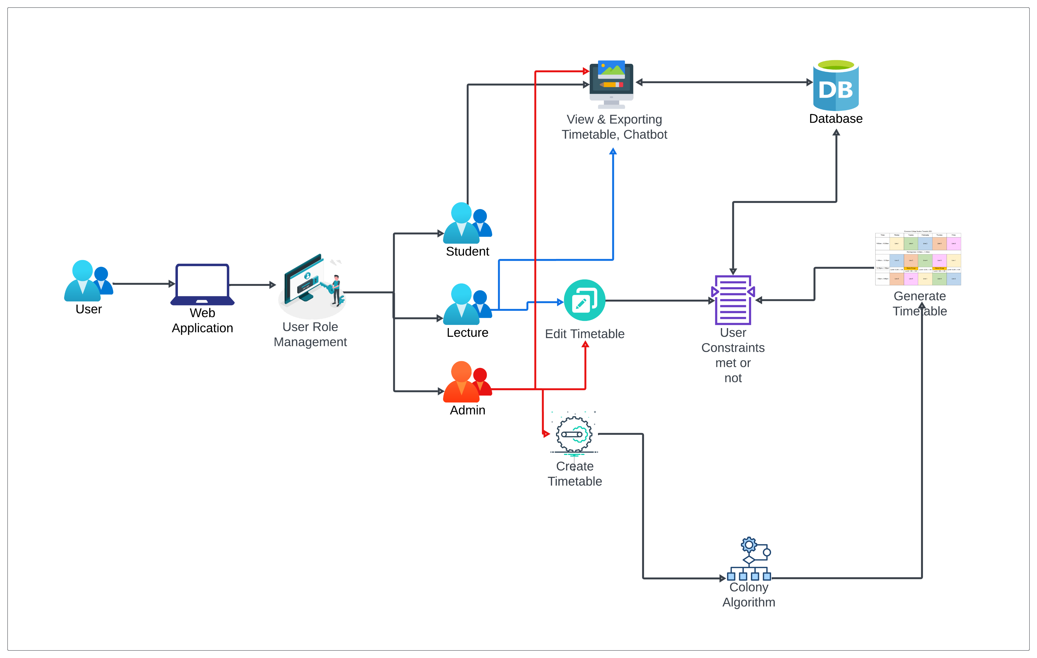
COMPONENT DIAGRAM
Colony Optimization for Timetable Scheduling & Manual Editing Feature
IT21172182 | Wijayawardhana G.L.C.N.D | IT21172182

Slide 44
Key Technology
Frontend Requirements
Programming Language - JavaScript
Libraries - React, ViteJS
Tools - NodeJS, Tailwind CSS
System Requirements
Operating System - Cross Platform
Software - Python, Node.js, PostgreSQL
Algorithm Requirements
Language - python
Libraries - NumPy, SciPy, ACO, Matplotlib
Environment - Jupiter Notebook
Backend Requirements
Programming Language - Python, Flask
Database - PostgreSQL
IT21172182 | Wijayawardhana G.L.C.N.D | IT21172182

Slide 45
PROJECT REQUIREMENT
Functional Requirement | Non-Functional Requirement
generate schedules using colony optimization techniques to ensure optimal allocation of time slots, spaces and resources Users must be able to manually edit the generated schedule through a user-friendly interface, with real-time conflict detection and resolution The system must detect conflicts The system must store schedules, pheromone levels, etc. user changes in a database to ensure data consistency and version control. | Performance Usability Reliability Scalability Security Maintainability Compatibility
IT21172182 | Wijayawardhana G.L.C.N.D | IT21172182

Slide 46
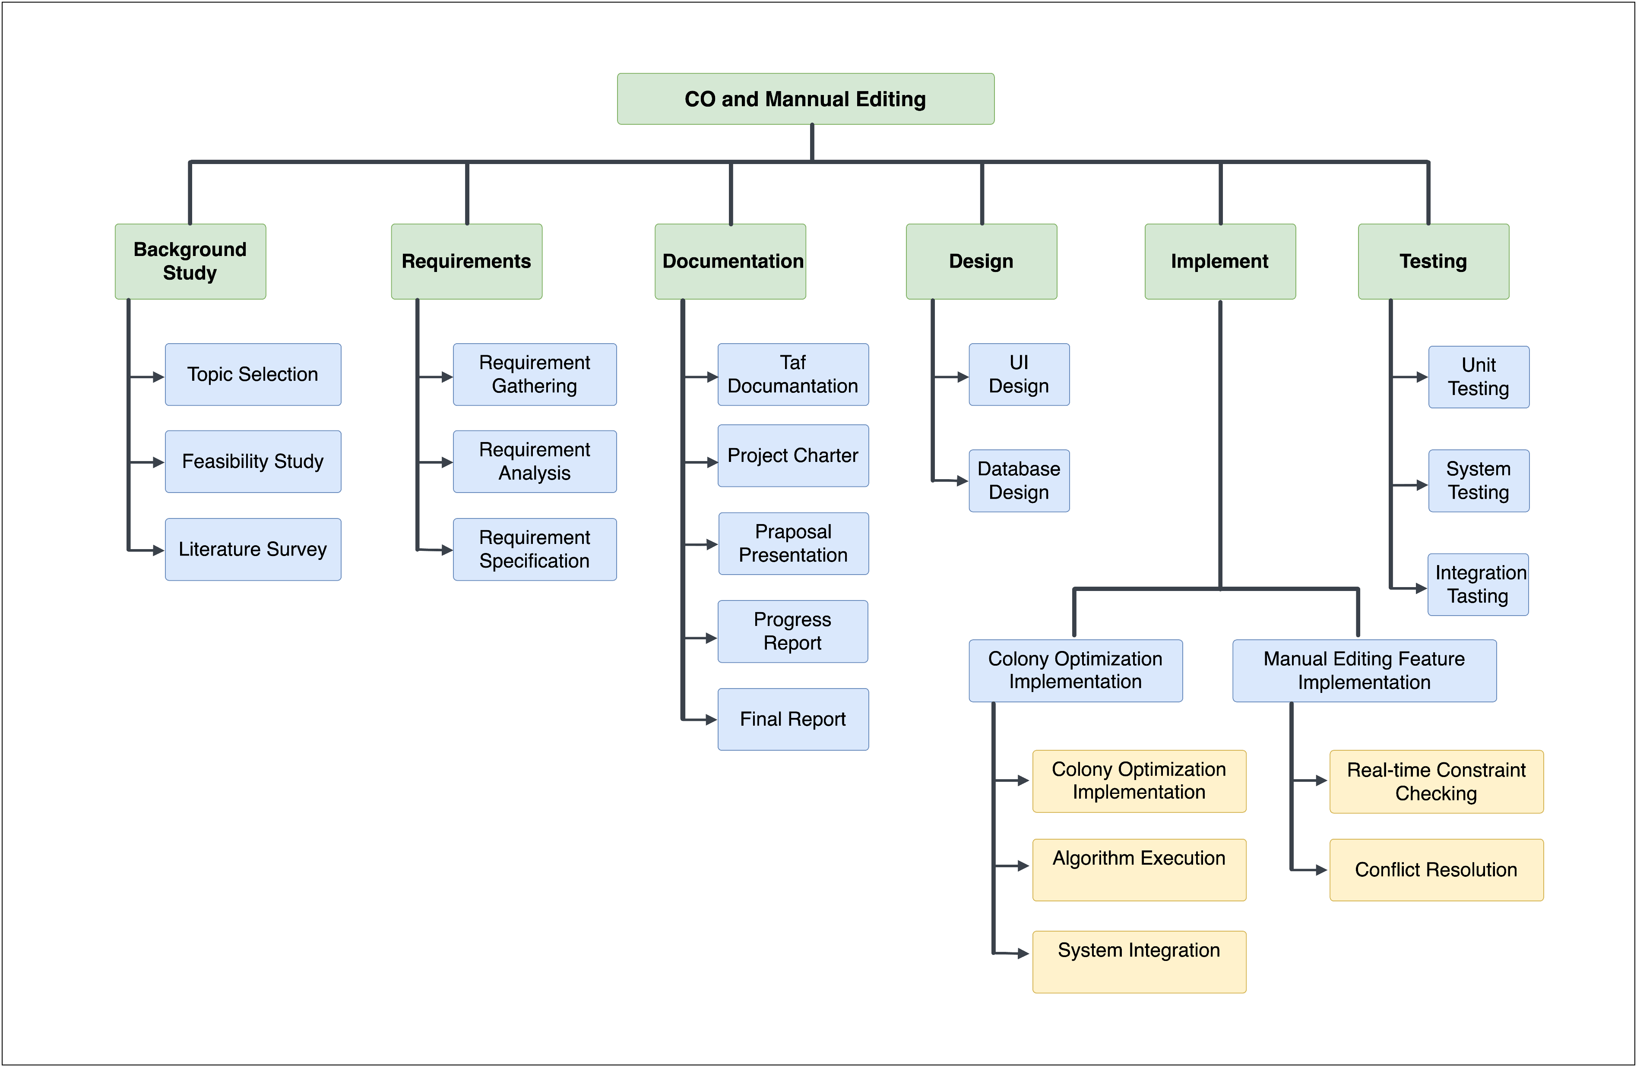
WORK BREAK DOWN STRUCTURE
IT21172182 | Wijayawardhana G.L.C.N.D | IT21172182

Slide 47
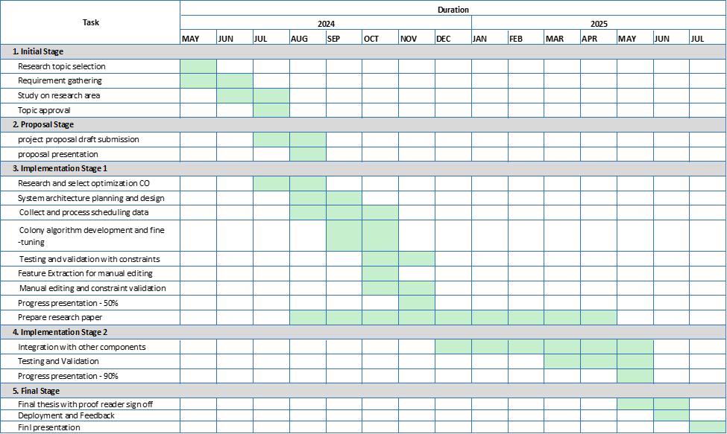
GANTT CHART
IT21172182 | Wijayawardhana G.L.C.N.D | IT21172182

Slide 48
REFERENCES
[1] L. Zuo, L. Shu, S. Dong, C. Zhu, and T. Hara, "A Multi-Objective Optimization Scheduling Method Based on the Ant Colony Algorithm in Cloud Computing," IEEE Access, vol. 7, pp. 1-9, 2019.
[2] B. Kumar and D. Kumar, "A review on Artificial Bee Colony algorithm," International Journal of Engineering and Technology, vol. 7, no. 4, pp. 1-5, 2018.
[3] V. Sahargahi and M. R. F. Derakhshi, "Research Paper: Comparing the Methods of Creating Educational Timetable," Journal of Computer and Information Science, vol. 9, no. 4, pp. 1-6, 2016.
[4] P. Pongchairerks, "Particle swarm optimization algorithm applied to scheduling problems," International Journal of Industrial Engineering, vol. 27, no. 3, pp. 1-7, 2017.
[5] D. Ojha, R. Kumar Sahoo, and S. Das, "Automated Timetable Generation using Bee Colony Optimization," International Journal of Applied Information Systems (IJAIS), vol. 12, no. 5, pp. 1-8, 2019.
[6] M. Mazlan, M. Makhtar, A. F. K. A. Khairi, and M. A. Mohamed, "University course timetabling model using ant colony optimization algorithm approach," IEEE Access, vol. 8, pp. 1-9, 2019.
IT21172182 | Wijayawardhana G.L.C.N.D | IT21172182

Slide 49
IT21266164 Udayantha d.m.s
BSc (Hons) Degree in Information Technology (specialization in Information Technology)
IT21266164 | Udayantha D.M.S | 24-25J-238

Slide 50

Component 4: Research and Develop an
Effective Timetable Evaluation method
Introduction
Research Gap
Research Problem
Specific and Sub Objective
IT21266164 | Udayantha D.M.S | 24-25J-238

Slide 51
INTRODUCTION
Develop a robust system to evaluate university timetables generated by advanced algorithms.
Assessing timetables generated by various algorithms (GA, RL, CO)
Scoring Mechanism
Components:
Hard and soft constraint evaluation
Resource utilization metrics
Organizational goal alignment
Chatbot Integration:
Allows lecturers and students to check lecture times, locations, and other relevant details through a chatbot interface.
IT21266164 | Udayantha D.M.S | 24-25J-238

Slide 52
RESERCH GAP
Research Focus | Evaluation Criteria | Scoring Mechanism | Real-Time Adaptation | User Satisfaction
Genetic Algorithm | Yes | Yes | No | No
Colony Algorithm | Yes | No | Yes | Yes
Reinforcement Algorithm | Yes | Yes | Yes | Yes
Evaluation System | Yes | Yes | Yes | Yes
IT21266164 | Udayantha D.M.S | 24-25J-238

Slide 53
RESEARCH QUESTION
“How can a comprehensive timetable evaluation system, incorporating advanced algorithms, effectively assess and optimize university timetables to meet specific constraints, enhance resource utilization, and align with organizational goals?”
IT21266164 | Udayantha D.M.S | 24-25J-238

Slide 54
Main AND SUB OBJECTIVE
Main Objective
Develop a comprehensive timetable evaluation system that rigorously assesses university schedules generated by advanced algorithms, ensuring they meet specified constraints, optimize resource utilization, and align with organizational goals.
Sub Objective
Evaluate Constraint Compliance
Develop a Scoring Mechanism:
Create a comprehensive scoring system that integrates constraint adherence, resource optimization, workload balance, and other critical factors.
Compare Algorithm Performance:
Analyze the effectiveness of different algorithms in generating optimal timetables.
IT21266164 | Udayantha D.M.S | 24-25J-238

Slide 55
METHOLOGY
Component Diagram
Project Requirement
Work Break Down Structure
IT21266164 | Udayantha D.M.S | 24-25J-238

Slide 56
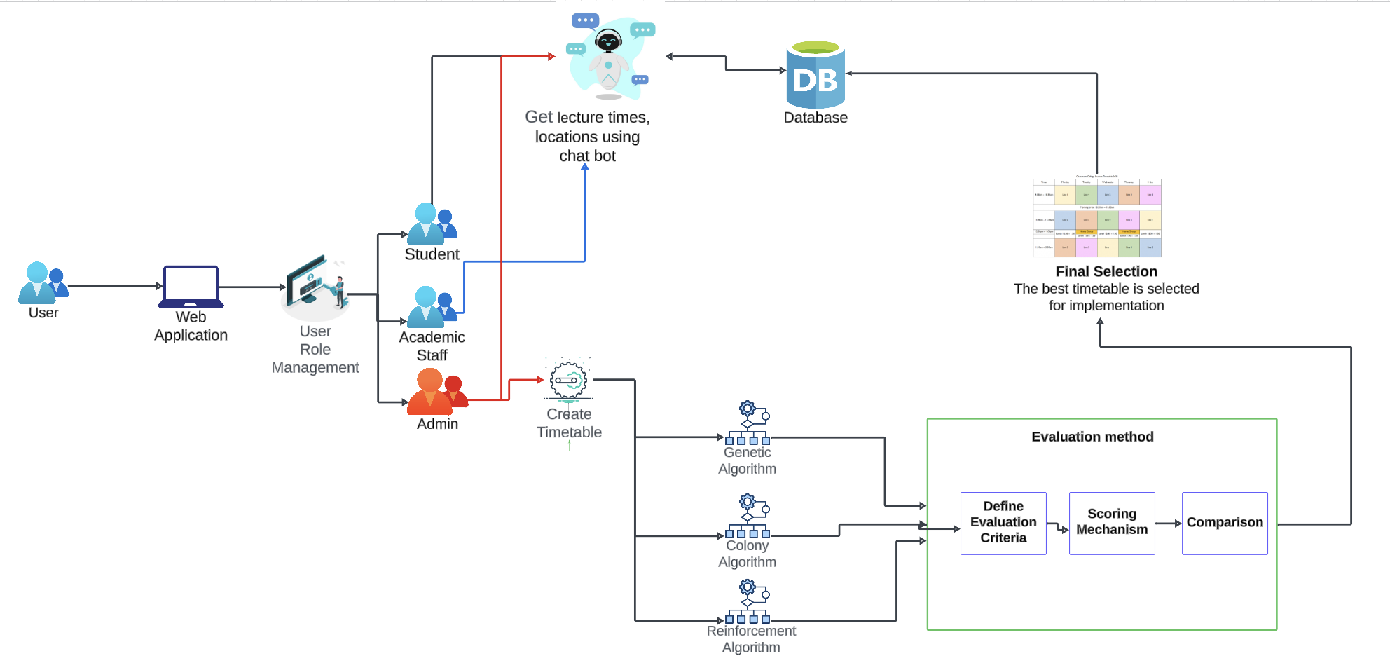
COMPONENT DIAGRAM
Colony Optimization for Timetable Scheduling & Manual Editing Feature
IT21266164 | Udayantha D.M.S | 24-25J-238

Slide 57
Key Technology
Frontend Requirements
Programming Language - JavaScript
Libraries - React, ViteJS
Tools - NodeJS, Tailwind CSS
System Requirements
Operating System - Cross Platform
Software - Python, Node.js, PostgreSQL
Algorithm Requirements
Language - python
Libraries - NumPy, SciPy, ACO, Matplotlib
Environment - Jupiter Notebook
Backend Requirements
Programming Language - Python, Flask
Database - PostgreSQL
IT21266164 | Udayantha D.M.S | 24-25J-238

Slide 58
PROJECT REQUIREMENT
Functional Requirement | Non-Functional Requirement
The system must accept timetables generated by various scheduling algorithms and allow the input of relevant constraints, room information, instructor availability, and course priorities. The system must identify and penalize violations of hard constraints like scheduling conflicts and room overcapacity, and assess soft constraint violations appropriately. The system must calculate a comprehensive score for each timetable, accounting for constraint violations, objective achievements, resource use, workload balance, compactness, and priority handling. The system must clearly rank timetables based on quality and criteria adherence, enabling easy comparison and selection. | Performance Usability Reliability Scalability Security Maintainability Compatibility
IT21266164 | Udayantha D.M.S | 24-25J-238

Slide 59
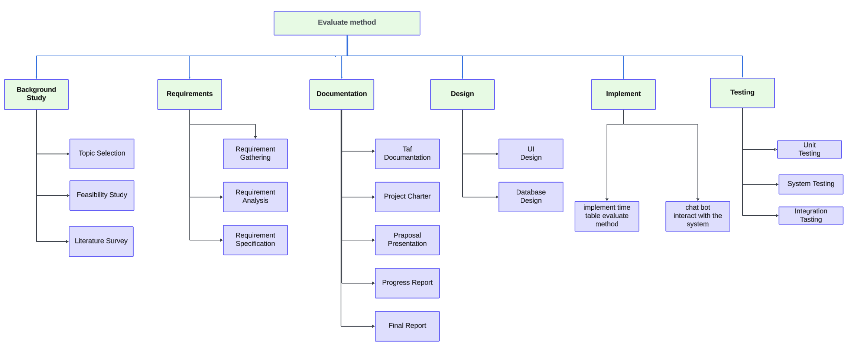
WORK BREAK DOWN STRUCTURE
IT21172182 | Wijayawardhana G.L.C.N.D | IT21172182

Slide 60
GANTT CHART
IT21266164 | Udayantha D.M.S | 24-25J-238

Slide 61
REFERENCES
[1] Sahargahi, Vahideh, and Mohammadreza Feizi Drakhshi. "Comparing the methods of creating educational timetable." International Journal of Computer Science and Network Security (IJCSNS) 16.12 (2016): 26.
[2] Bashab, Abeer, et al. "Optimization Techniques in University Timetabling Problem: Constraints, Methodologies, Benchmarks, and Open Issues." Computers, Materials & Continua 74.3 (2023).
[3] Adrianto, Dennise. "Comparison using particle swarm optimization and genetic algorithm for timetable scheduling." Journal of Computer Science 10.2 (2014): 341.
[4] Mauluddin, S. Y. A. H. R. U. L., I. S. K. A. N. D. A. R. Ikbal, and A. G. U. S. Nursikuwagus. "Complexity and performance comparison of genetic algorithm and ant colony for best solution timetable class." J. Eng. Sci. Technol 15.1 (2020): 276-290.
[5]
IT21266164 | Udayantha D.M.S | 24-25J-238

Slide 62

Commercialization Aspects
Introduce as a Subscription Service for Timetable Generation in state and Non state universities in Sri Lanka
In Further Steps introduce into School Systems in Sri Lanka in a version II
Expand beyond Educational Realm where Scheduling considered key component in industry

Slide 63
Budget
Component | Amount in USD | Amount in LKR
Internet And Deployment Costs (Azure Free Credit) | 100 | 30,000
Technical consultation charges (External technical information session, Online courses) | 20 | 6000
Total | 120 | 36,000

